Slide 1

NATURAL LANGUAGE PROCESSING

Slide 2
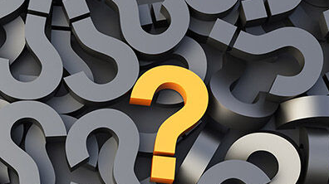
Favorite emoji?

Slide 3

HANDLING TEXT IN ML
So far, the algorithms that we have seen take as input tabular information with numeric or categorical data.
There are several areas of application where our data is not natively structured in this way: sound, image and text come to mind
In these situations we often reduce the problem to turning the native data format into a suitable set of features, followed by applying the typical ML algorithms.
In other words: how do we turn text into a suitable set of numbers?

Slide 4
What is NLP?
A branch of AI focusing on interactions between computers and human languages.
Enables analysis, understanding, and generation of meaningful natural language.
Key Areas:
1. Text Classification: Categorizing text (e.g., spam detection, sentiment analysis).
2. Named Entity Recognition (NER): Identifying entities like names, locations, and organizations.
3. Machine Translation: Translating text or speech between languages.
4. Speech Recognition: Converting spoken words into text.
5. Text Summarization: Creating concise summaries of longer texts.
6. Question Answering: Developing systems to answer natural language questions.

Slide 5
VADER

Slide 6
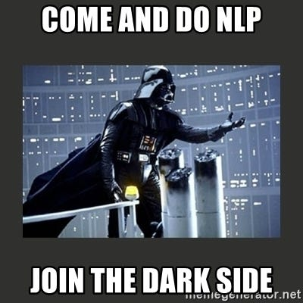
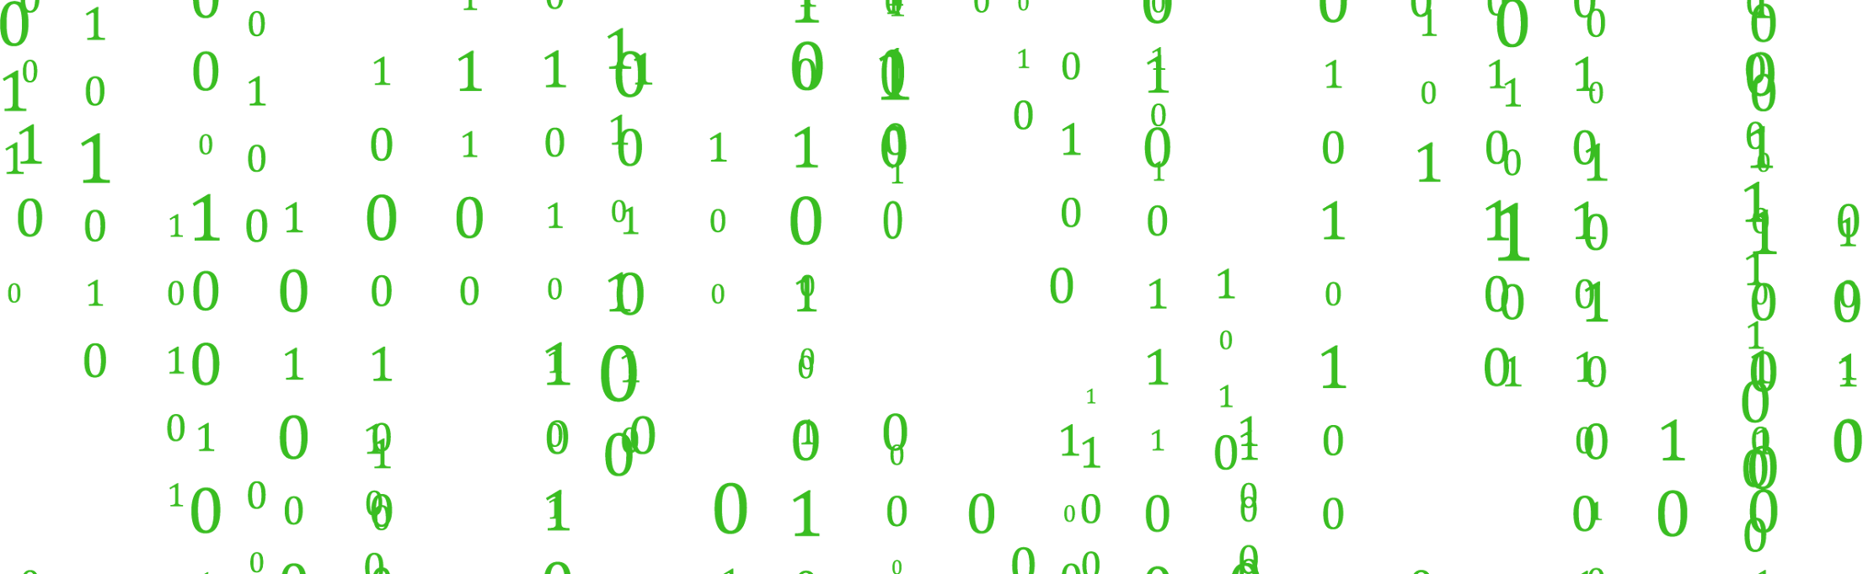
What is VADER?
🧠 VADER: Valence Aware Dictionary and Sentiment Reasoner
Is a lexicon and rule-based sentiment analysis tool designed for informal text (social media, reviews, comments).
⚙️ Key Features:
Uses a Bag of Words approach (word-based scoring).
Includes rules to handle emojis, slang, and context modifiers.
Part of NLTK for quick sentiment evaluation.

Slide 7
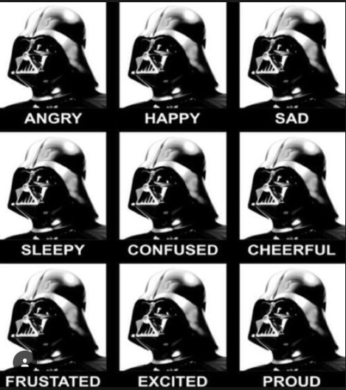
How VADER Works
📚 Is a Dictionary of Sentiments Scores VADER
Words (e.g.”amazing”) are assigned positive or negative scores.
⚙️ Rule-Based:
Handles negations: "not good" → reduces positivity.
Handles intensifiers: "very good" → increases positivity.
Compound Score: Combines positive, neutral, and negative scores into one overall sentiment.

Slide 8

✅ Strengths of VADER:
Beginner-Friendly: Easy to use and implement.
Fast: Optimized for small-scale projects.
Handles Informal Text: Recognizes slang, emojis, and acronyms.
Great for social media analysis.

Slide 9
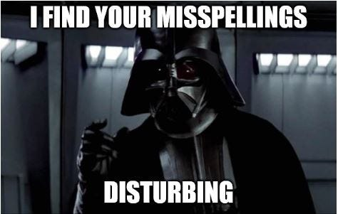
❌ Weakness of VADER:
No Context Awareness: Fails with sarcasm or complex sentences.
"This is not bad" → "bad" (wrong sentiment)
Limited Adaptability: Struggles with domain-specific text.

Slide 10
BAG OF WORDS
Bag of Words model is a standard way to decompose any text into several features that can then be used to train a classifier.
The method consists of taking all the words from all the corpuses/documents/rows and performing one-hot encoding. However, the final value is a frequency of the word rather than a binary variable
In essence, each distinct word becomes a feature and the value represents frequency (not meaning).

Slide 11
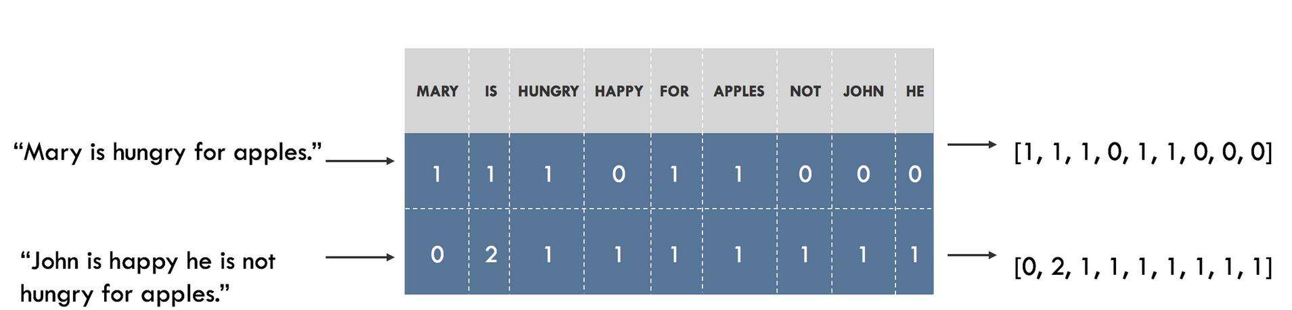
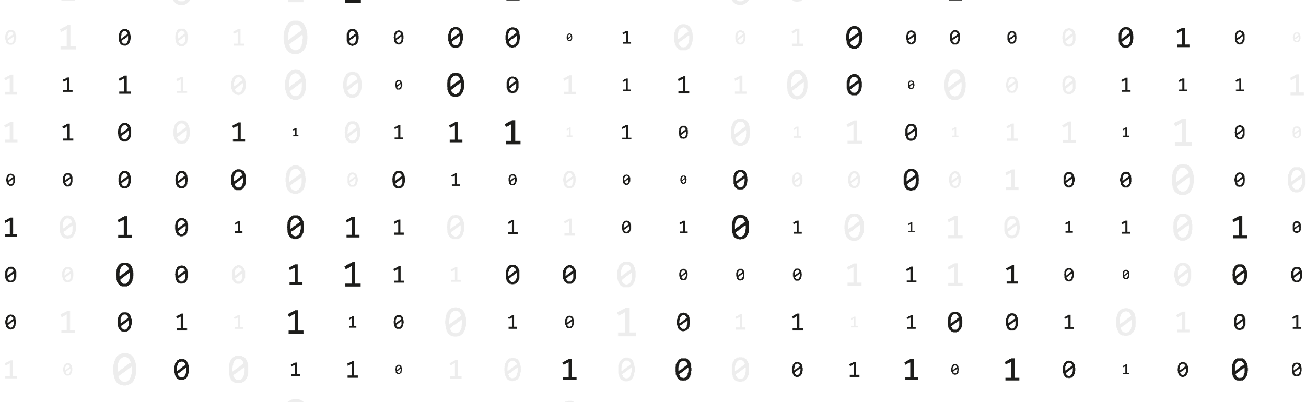
How Bag Of Words Works:
Splits the text into words (tokenization)
Count the frequency of each word
Creates a matrix

Slide 12
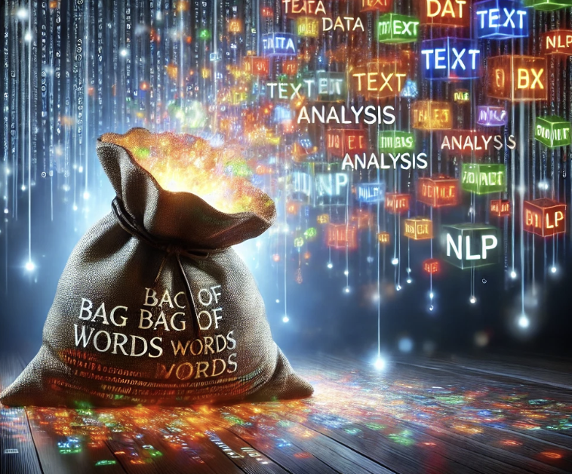
✅ Strengths of Bag of Words:
Simple & Effective: Easy to implement.
Frequency-Based: Captures how often a word appears.
Baseline Model: A starting point for text classification tasks.
❌ Weaknesess of Bag of Words:
Treats words as independent (e.g., "not bad" → "bad").
Large vocabulary = many zeroes in the matrix.
Ignores Order: "John loves Mary" = "Mary loves John".

Slide 13
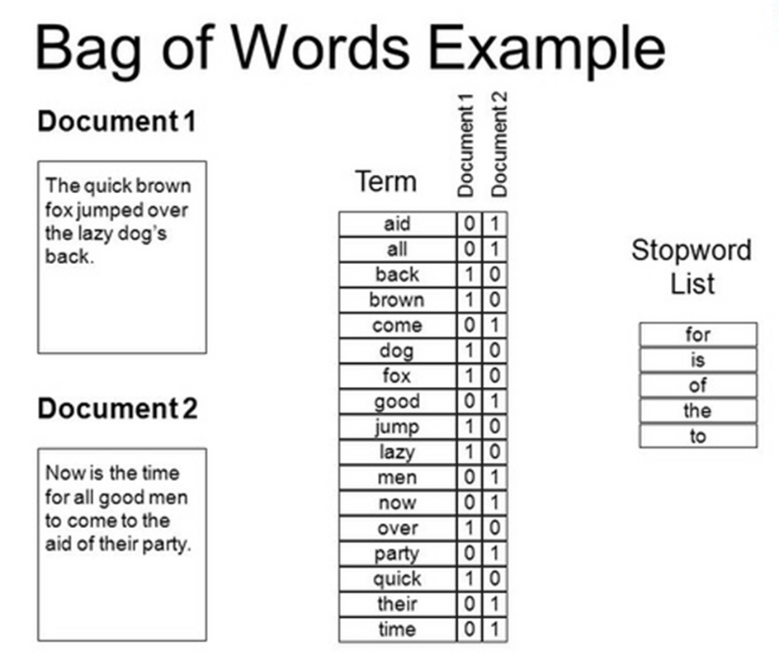
Solving Bag of Words Issues
Solution N-Grams performing bag of words but with pairs of sequential words for example:
"this is" ; "is not" ; "not bad" would be your features

Slide 14
TRANSFORMERS

Slide 15
What are Transformers?
🧠 Transformers are neural networks designed to process sequential data (e.g., text).
They introduced the self-attention mechanism to capture context efficiently.
📈 Why:
Used for translation, summarization, sentiment analysis, and more.
Captures meaning over long sequences.
Fast and scalable for NLP tasks.
Handle long-range dependencies in text better than RNNs.

Slide 16
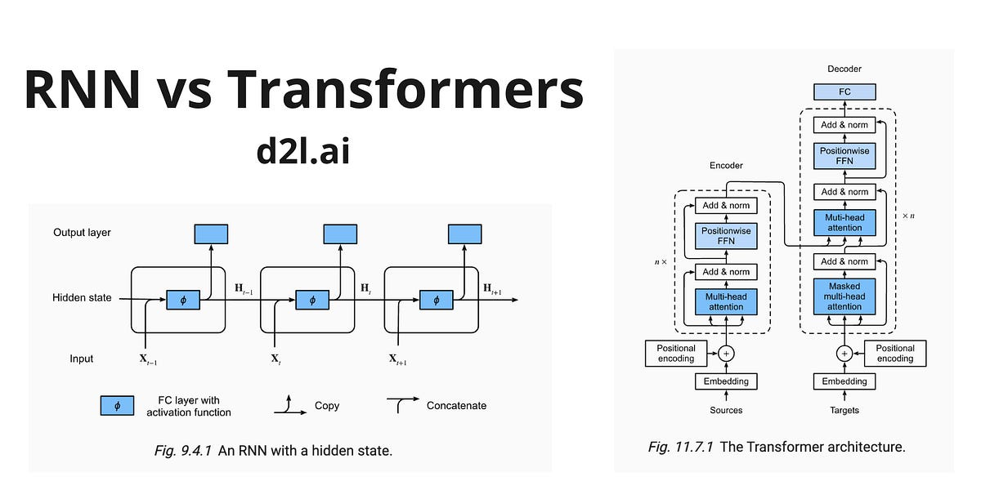
🔄 Recurrent Neural Networks (RNNs):
Process text sequentially (word by word).
Struggle with long-range dependencies.
Slower due to sequential computation.
⚡ Transformers:
Process text in parallel (entire sequence at once).
Handle long text efficiently using self-attention.
Faster and more scalable for modern NLP.

Slide 17
Key Features of Trasnformers
🔑 Features:
Self-Attention: Assigns importance to words based on context.
In "The cat chased the mouse" links "cat" with "chased" and "mouse".
Parallel Processing: Processes the entire sequence simultaneously, not word-by-word.
Encoder-Decoder Architecture
Encoder: Analyzes the input text (e.g., "Translate this to French").
Decoder: Generates the output text (e.g., "Traduisez ceci en français").
Works in tandem for tasks like translation and summarization.

Slide 18
Transformers Models
1️⃣ Encoder-Only Models:
Examples: BERT, RoBERTa
Focus: Understanding text.
2️⃣ Decoder-Only Models:
Examples: GPT
Focus: Generating text.
3️⃣ Encoder-Decoder Models:
Examples: T5, BART
Focus: Both understanding and generation.
Transformers Examples | Transformer Type | Unique Feature | Applications
BERT | Encoder-only | Contextual embeddings | Sentiment analysis, text search
GPT | Decoder-only | Text generation | Chatbots, storytelling
T5 | Encoder-Decoder | Unified text-to-text tasks | Translation, paraphrasing
RoBERTa | Encoder-only | Robust training | Language understanding
Vision Transformer (ViT) | Encoder-only | Image classification | Vision tasks

Slide 19
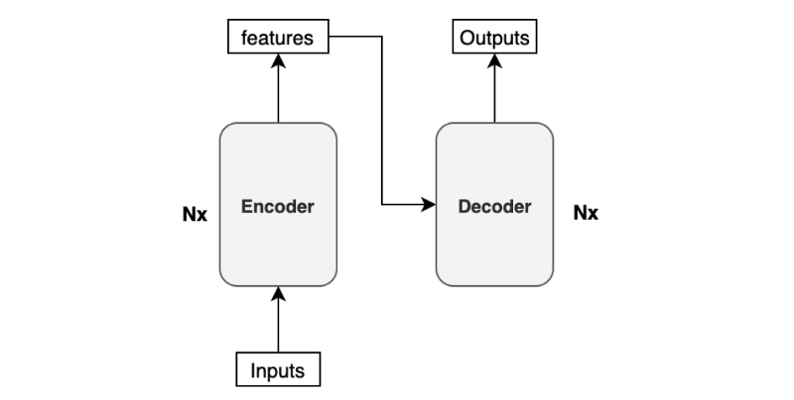

Slide 20
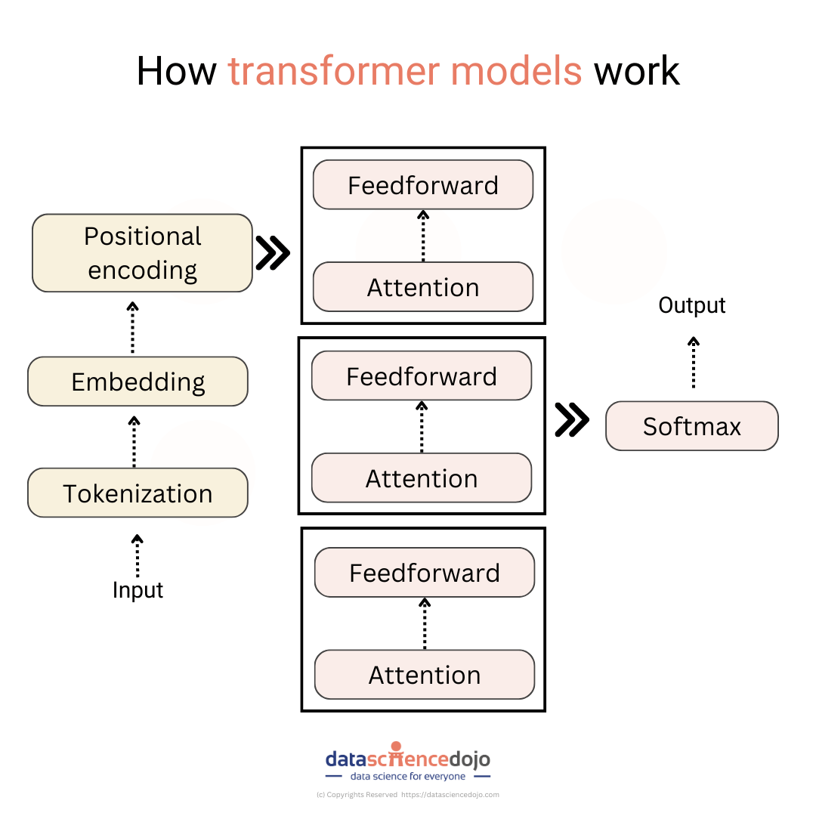
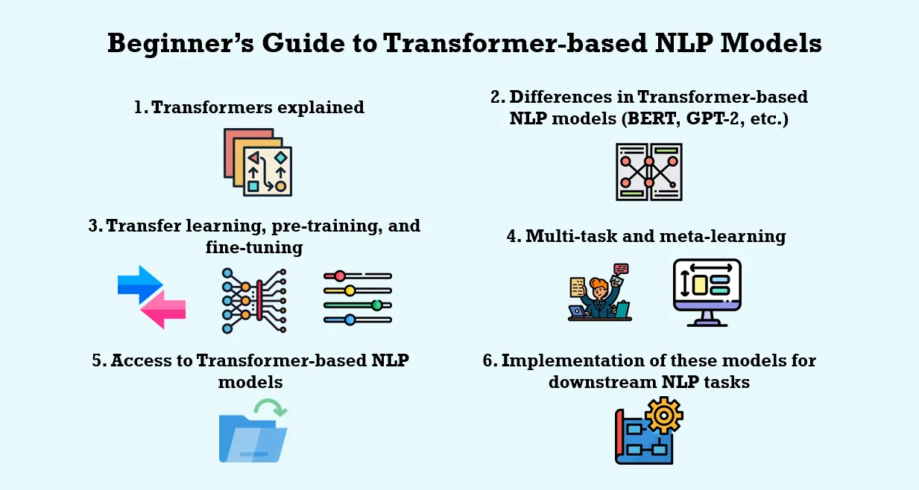
HOW
TRANSFORMERS
WORK
LINK!!!!

Slide 21
RoBERTa

Slide 22

Emotions Detected
🧠 RoBERTa, as a transformer model, can be fine-tuned to detect emotions in text.
📋 Emotions:
Anger: Frustration or hostility.
Disgust: Aversion or disapproval.
Fear: Apprehension or uncertainty.
Joy: Happiness or excitement.
Neutral: No strong emotional tone.
Sadness: Sorrow or grief.
Surprise: Shock or unexpected outcomes.

Slide 23
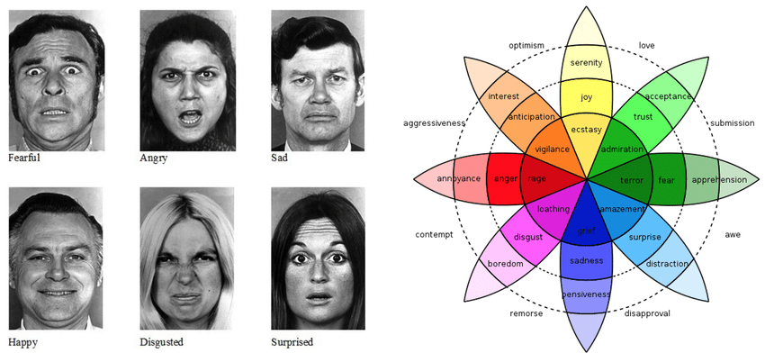
🌎
Ekman’s Psychology
Proposed by Dr. Paul Ekman.
Universal emotions experienced by all humans.
Recognized across cultures through facial expressions.
The 6 Basic Emotions: Anger, Disgust, Fear, Joy, Sadness, Surprise.

